Slide 1

M&M Muffins
Moanisha Velayuthem
n01482302

Slide 2
“Deliciously baked home made muffins which melts the heart and soul.”
- m&M mUFFINS

Slide 3
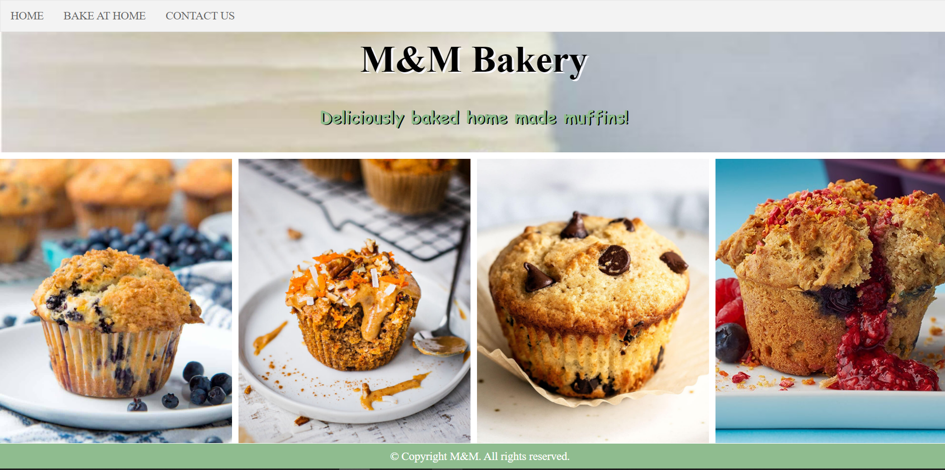
HOME PAGE
Header
Navigation menu to move across pages
Footer
Describes the copyright information
Displays the list of speciality muffins
offered by M&M

Slide 4
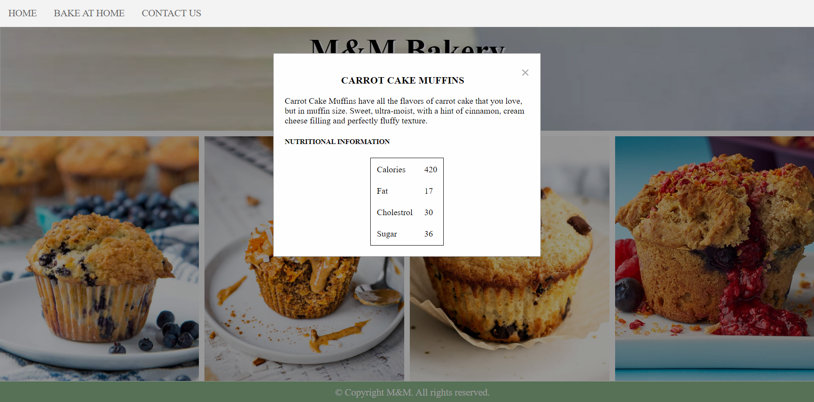
MUFFIN DETAILS
Click on each muffin to know more! The description and nutritional information ☺
Click on X button or anywhere outside to close the modal!

Slide 5
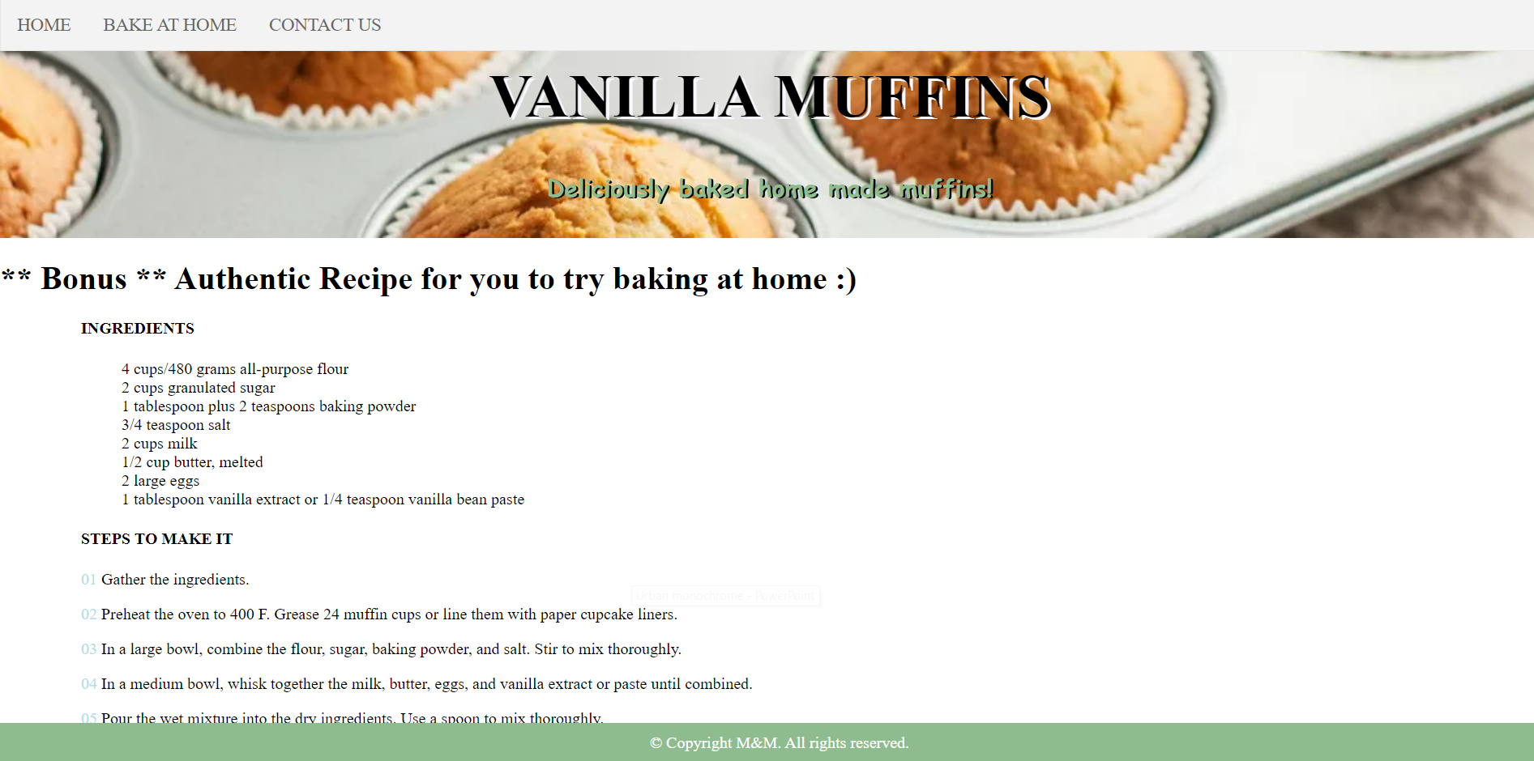
BAKE AT HOME
The navigation bar contains links to 3 pages – HOME, BAKE AT HOME, CONTACT US
Bake at home - Offers an authentic bonus muffin recipe to the users visiting the website!

Slide 6
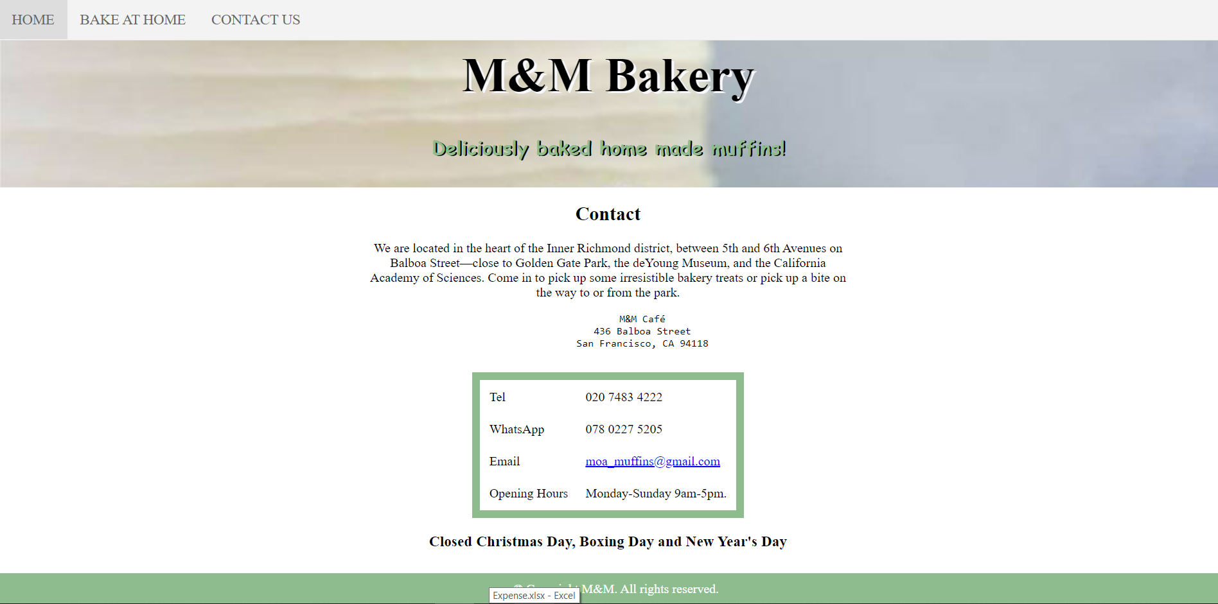
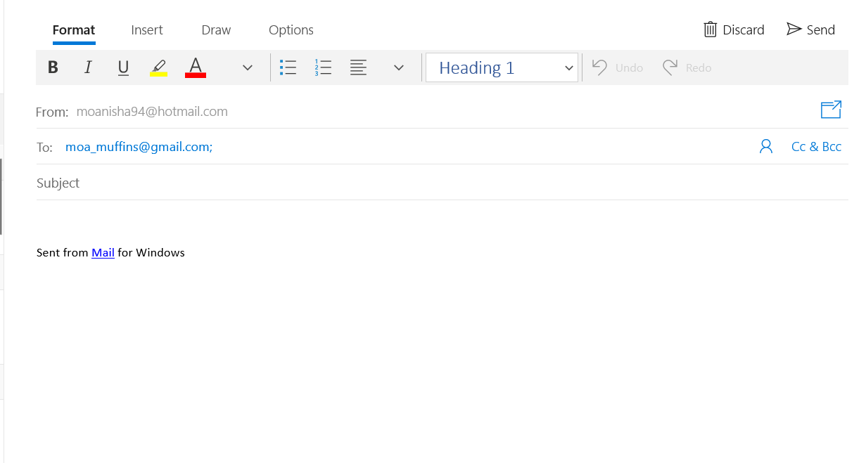
CONTACT US
Displays location, phone number and email! Click on the mail id to send an email

Slide 7
CONTACT US
Displays location, phone number and email! Click on the locations to view slideshow

Slide 8
THANK YOU

